Slide 1
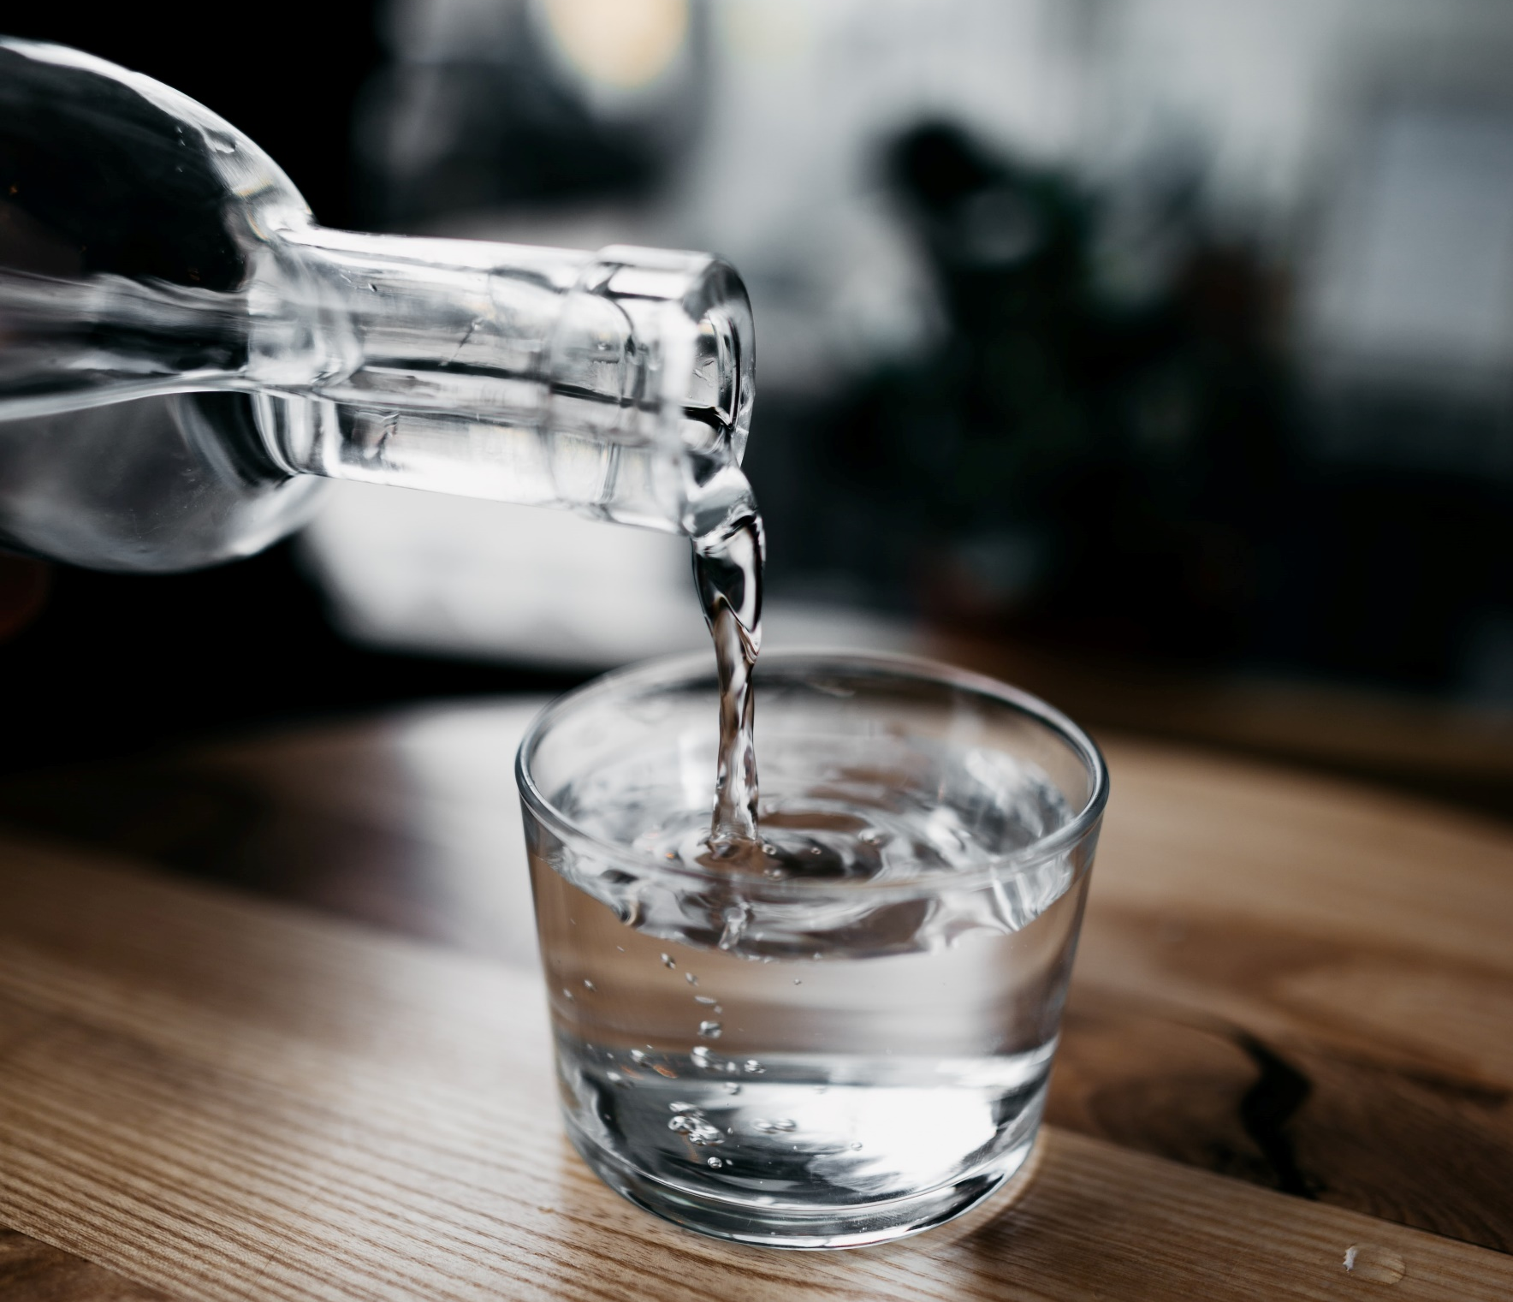
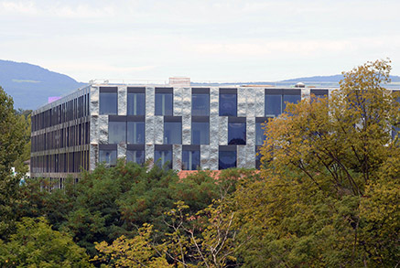
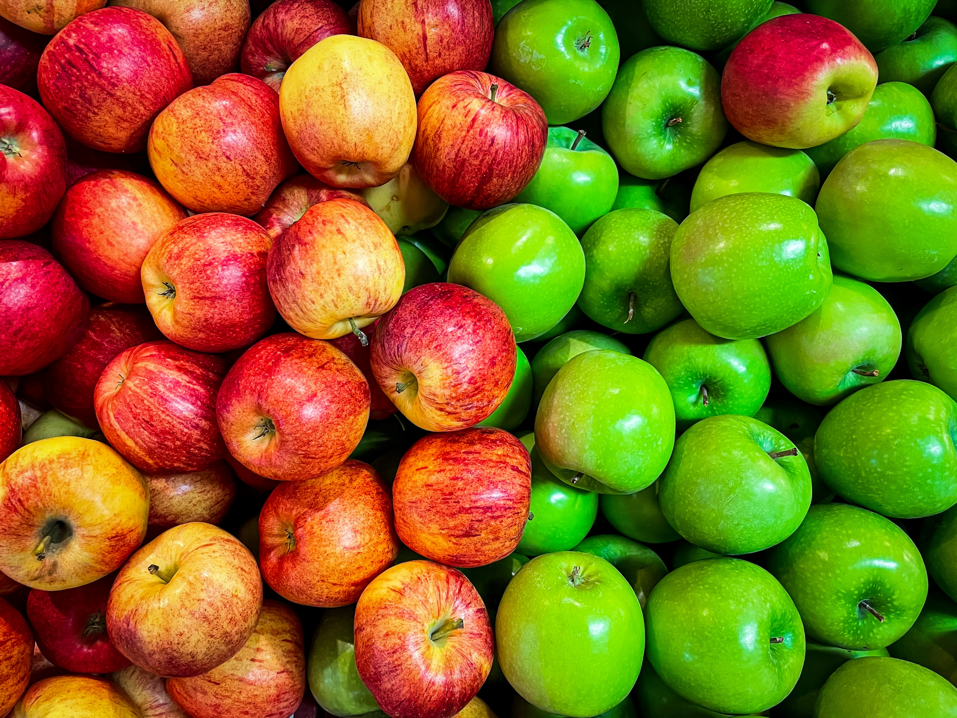
Min 60-75: Break

Slide 2


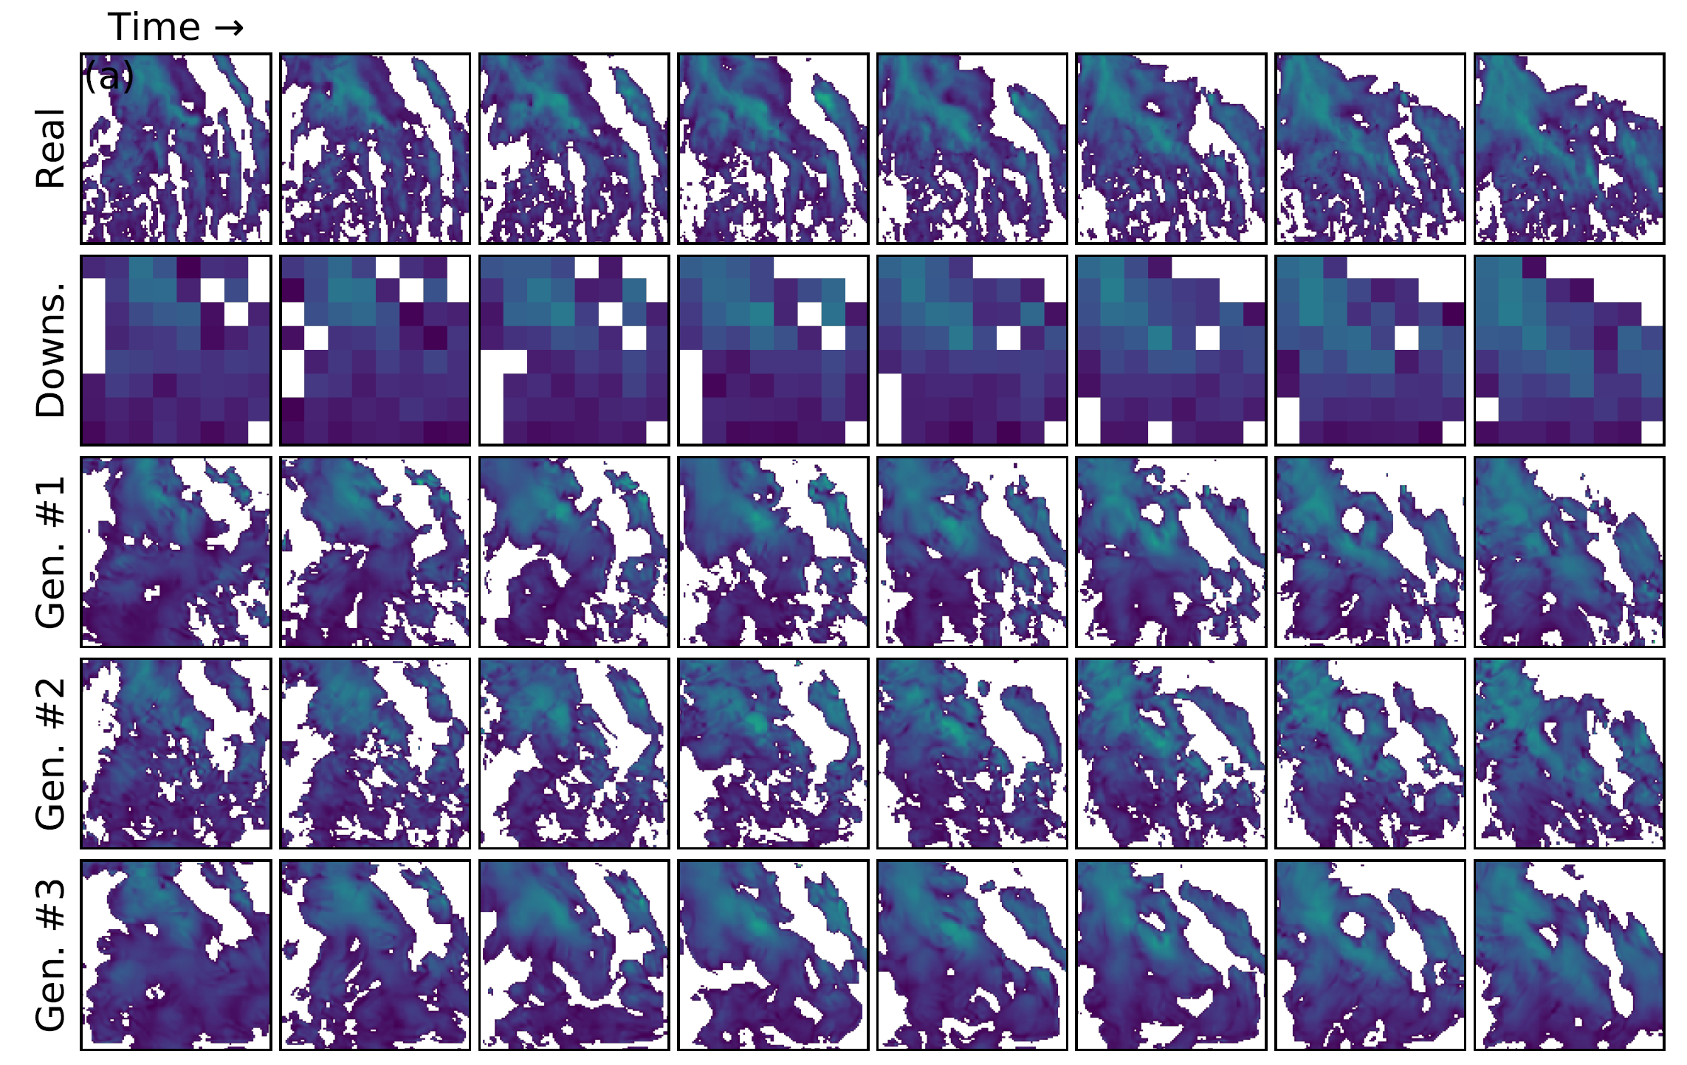
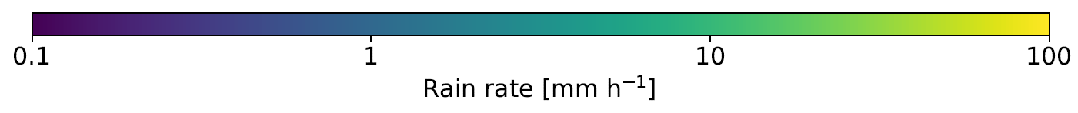
ML for Earth & Env Sci (Week 7, SP2022)
How can we add & evaluate uncertainty in our ML predictions?
Generated rain rates from the downsampled version of the real satellite image
Source: Leinonen et al. (2020)
Notes:
COSERO hydrological model

Slide 3

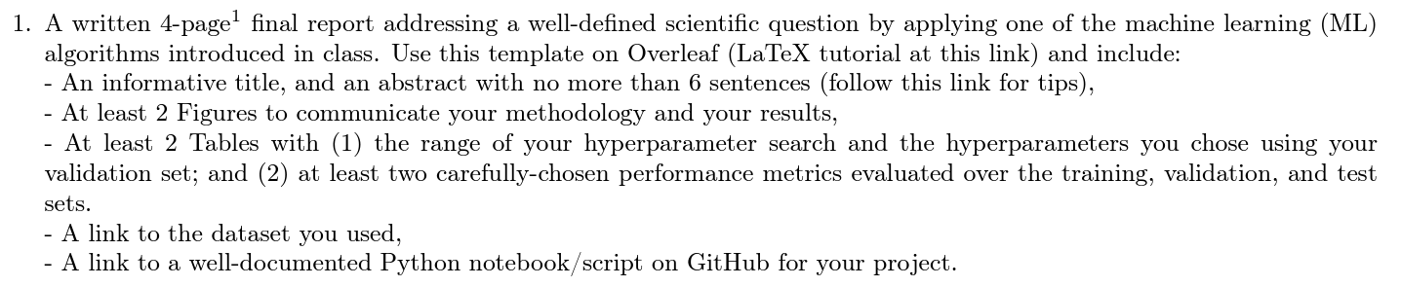
In-class Peer Review: Friday, Dec 8th, 2PM-4PM
Please use the same GitHub username as you used to fork the course’s repository
Submit first draft of your project by Thursday, Dec 7th

Slide 4
Final Presentations in room 2138 Friday, Dec 15th from 2PM to 4PM
Please register
4min presentations + 1min Q&A
Tip = 1 slide/minute
Scientific question: What’s our goal and why do we care?
Dataset: Characteristics, challenges, training/validation/test split, etc.
Methodology: Which ML algorithm(s) did you choose and why?
Results: What are your findings and how does it answer the sci. question?

Slide 5
Min 80-105: Introduction to Generative Modeling
Learning Objectives (Géron Ch17, Haynes et al.):
Define generative modeling
Know different ways of adding uncertainty to ML models
Understand how to evaluate such uncertainty estimates
Know three state-of-the-art generative models
Apprehend applications of latent data representations

Slide 6
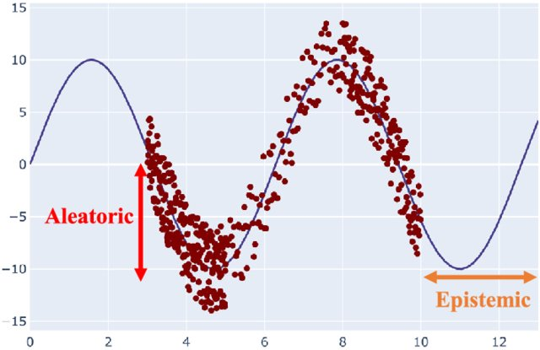
Generative models output distributions of outputs rather than a single output vector
Uncertainty Quantification
Stochastic Modeling
Abdar et al. (2021)
Notes:
VOTE: Which uncertainty can be reduced with more data?
VOTE2: Which of the three generated satellite image is most likely?

Slide 7
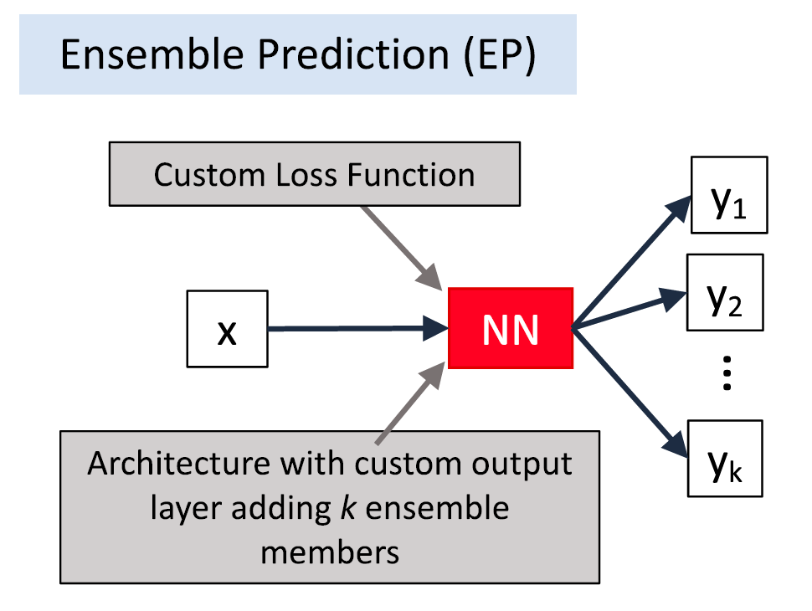
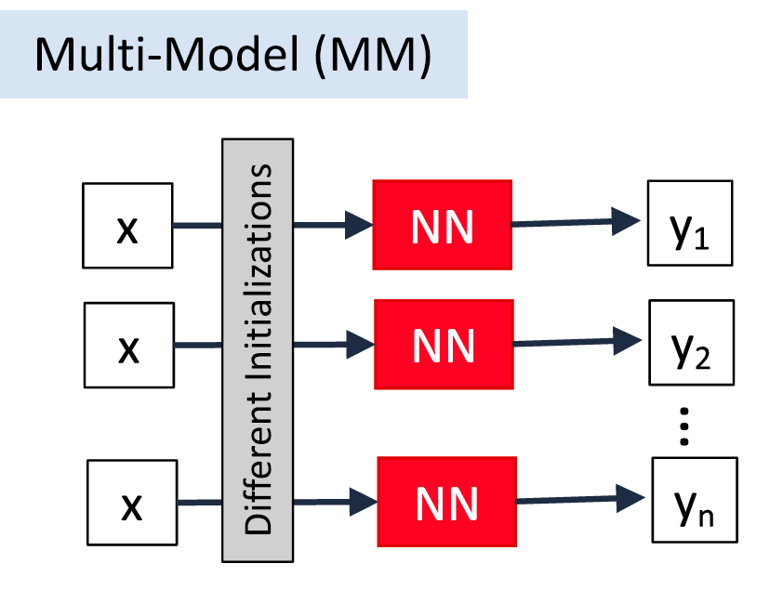
In practice, there are many ways of adding UQ!
Haynes et al. (2023)

Slide 8
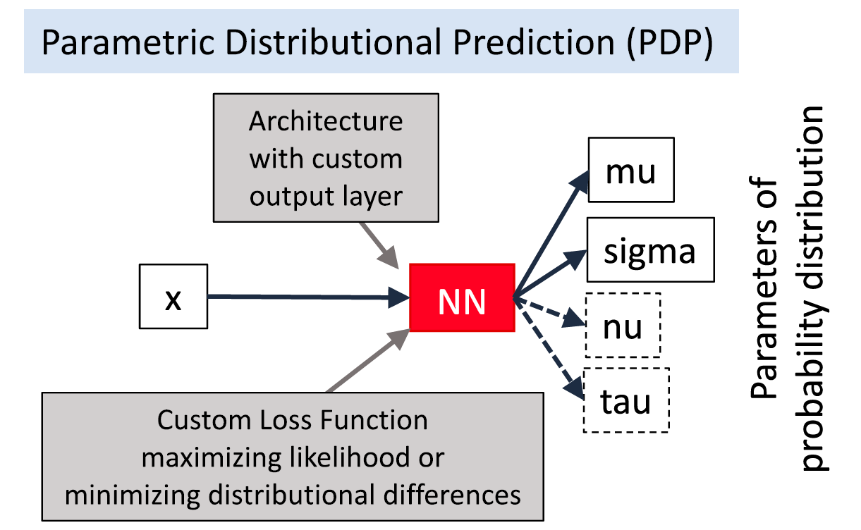
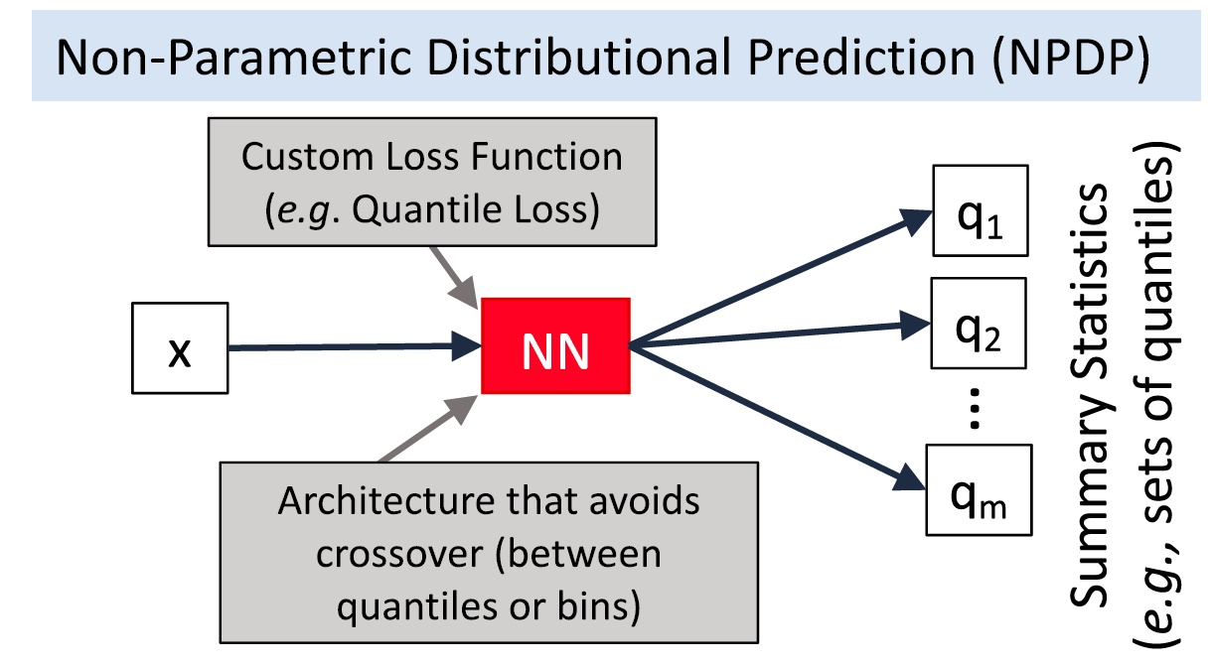
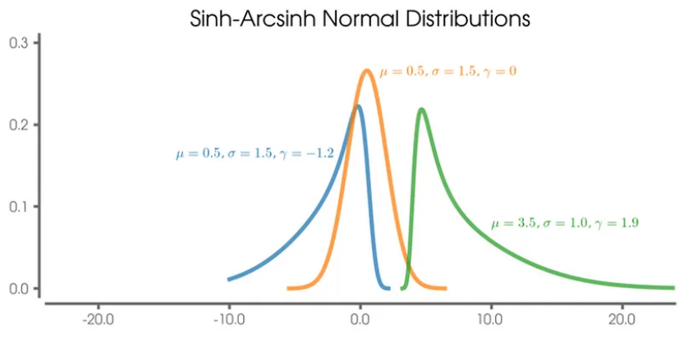
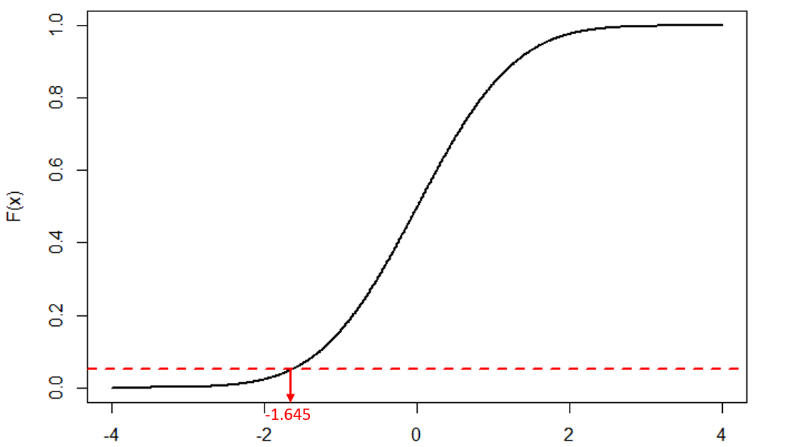
In practice, there are many ways of adding UQ!
Haynes et al. (2023). Kujawska et al. (2021)
Notes:
VOTE: Can you think of other methods?

Slide 9
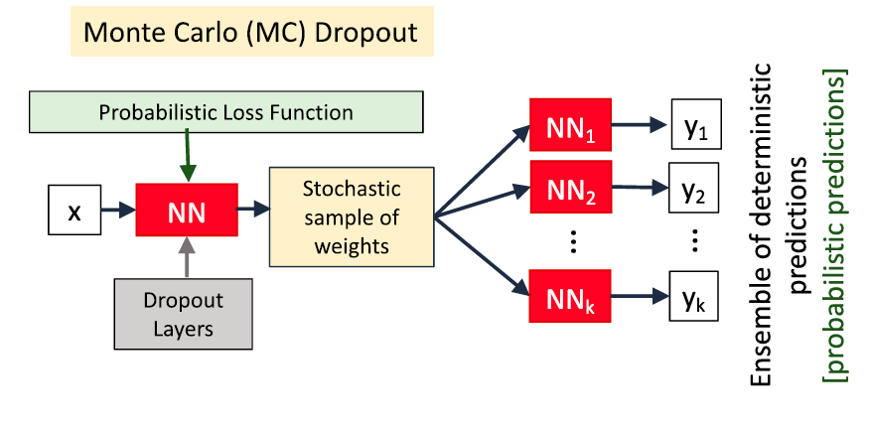
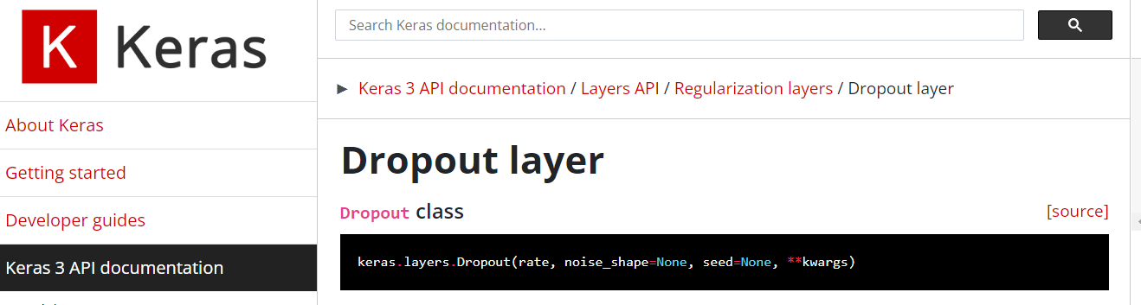
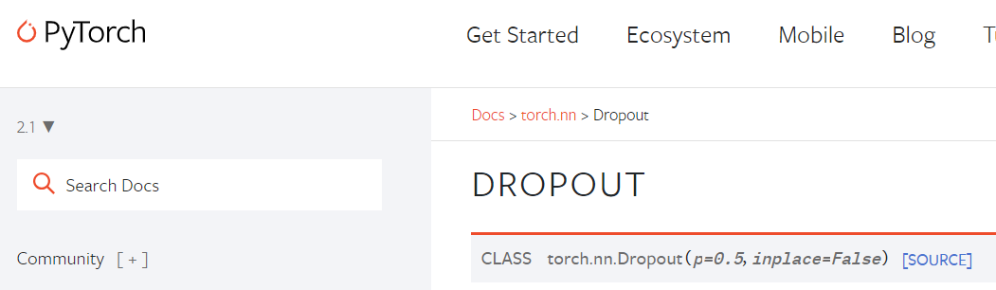
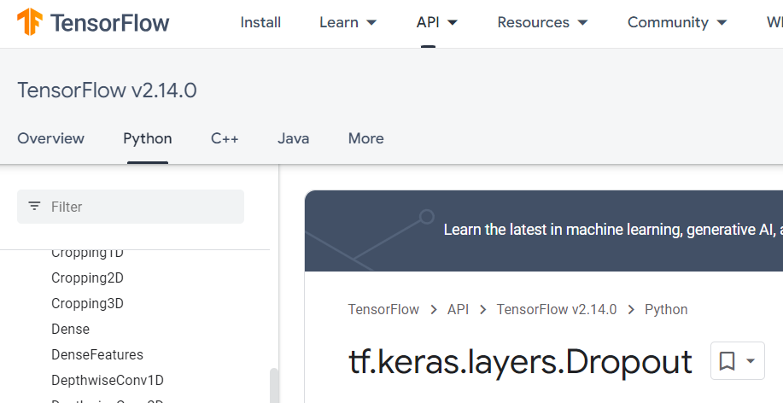

MC-Dropout randomly drops neural connections (Training) Regularization & (Test time) UQ

Slide 10
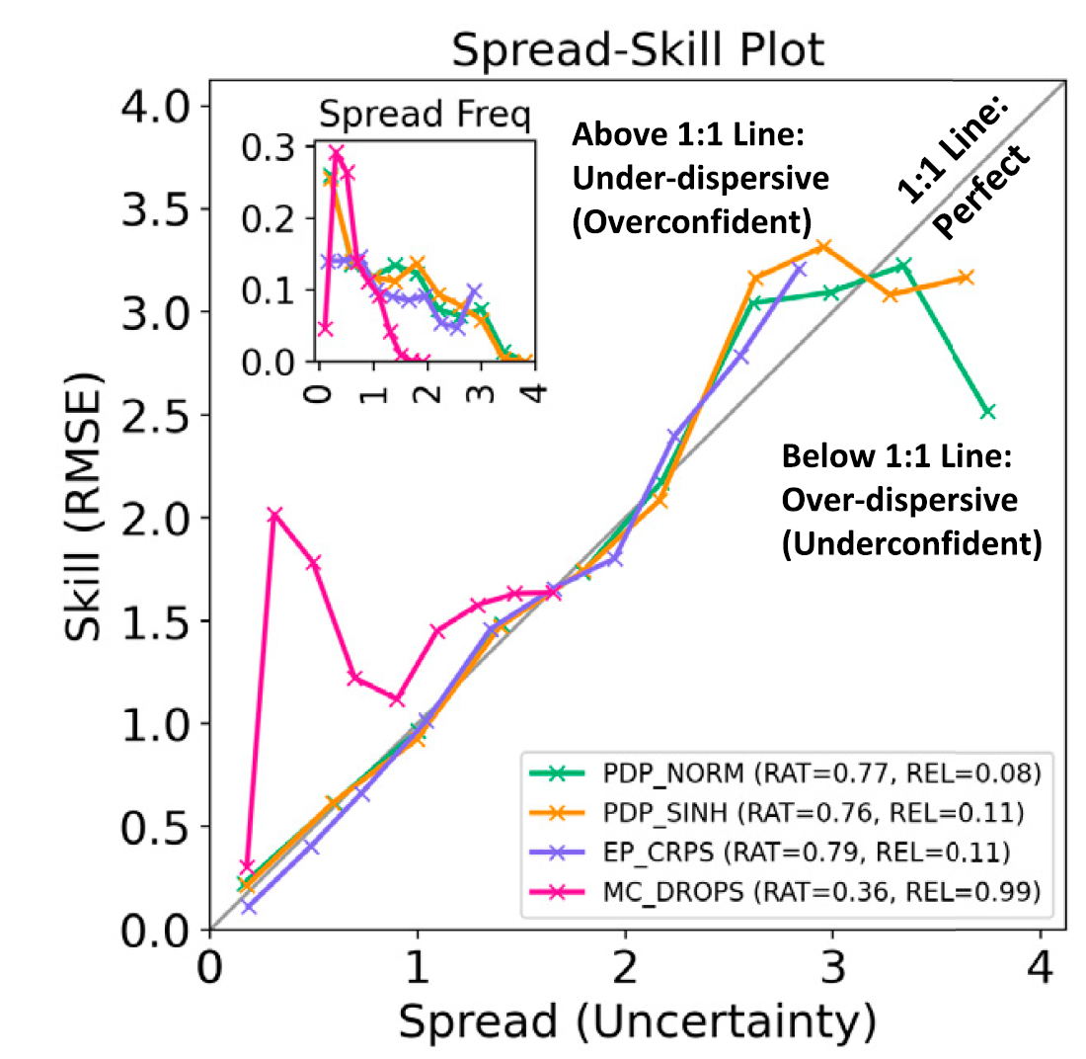
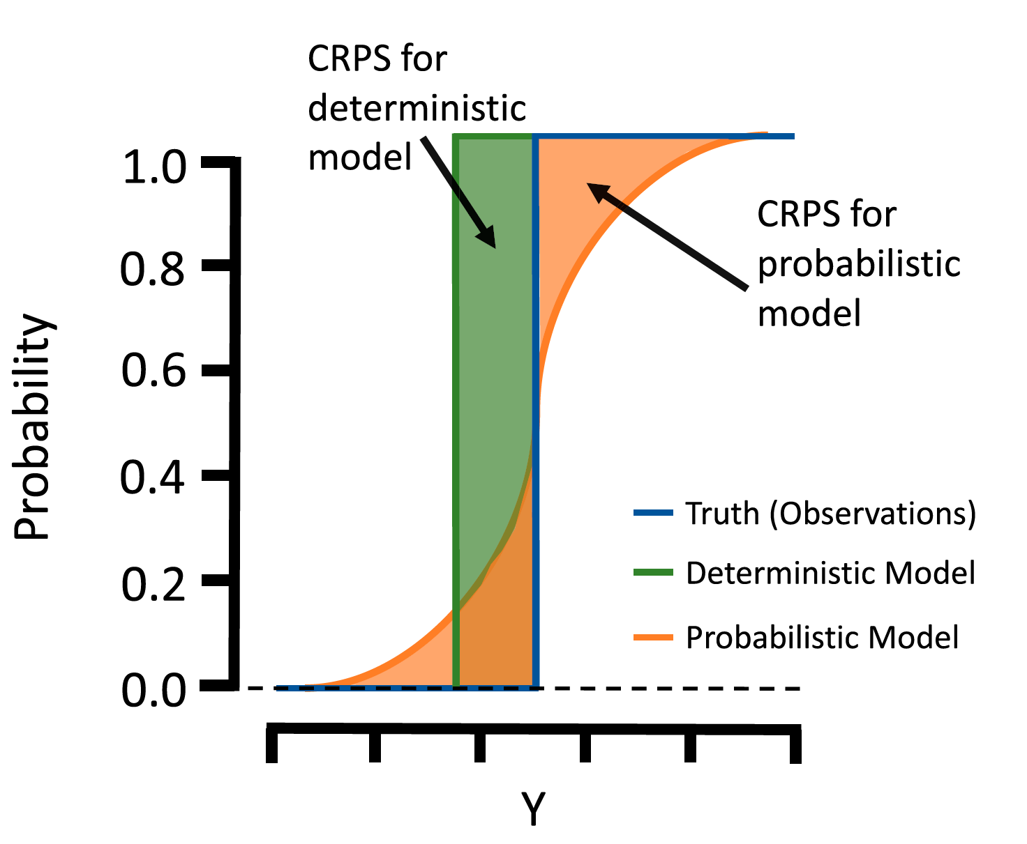
Spread-Skill Plot and CRPS* evaluate the generated distribution *(Continuous Ranked Prob. Score)
Notes:
Build intuition with simple case?

Slide 11
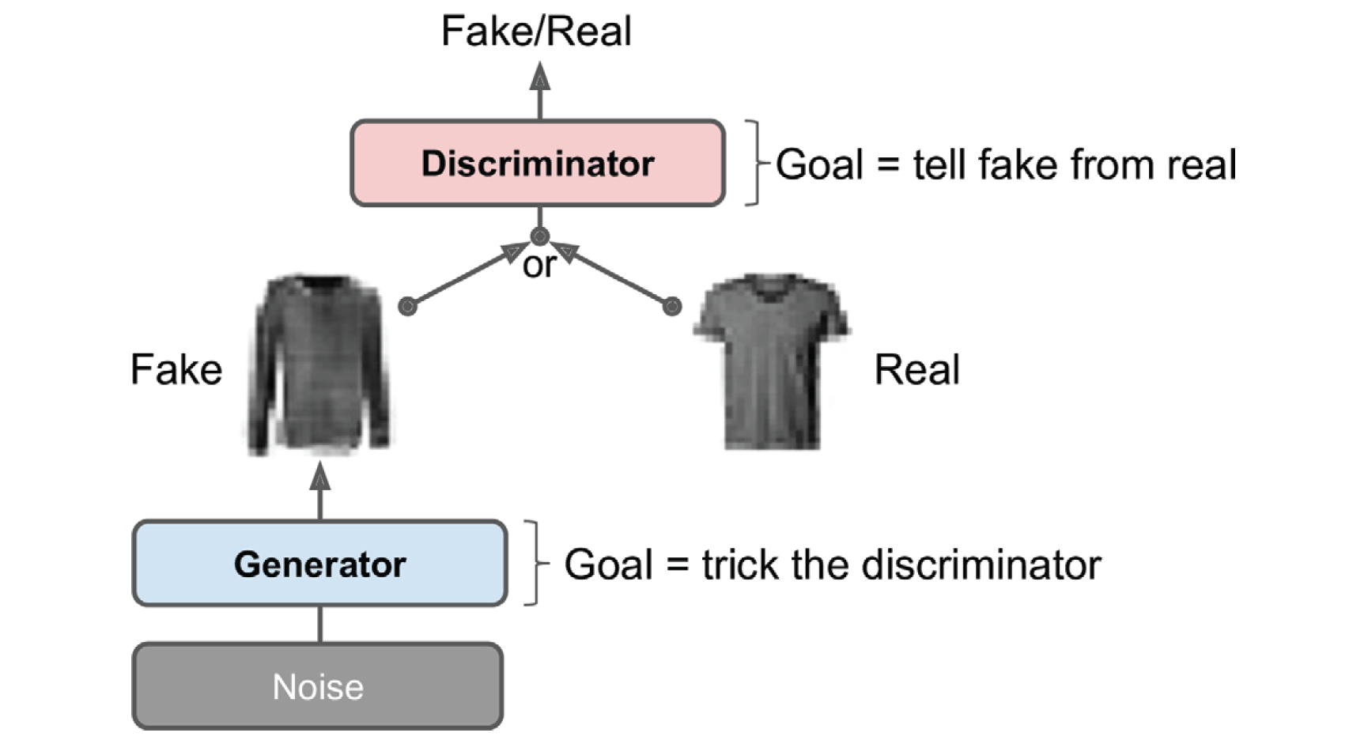
1) Generative Adversarial Nets pit a generator (fed noise) against a discriminator (fed the fake or real images)
Géron textbook

Slide 12
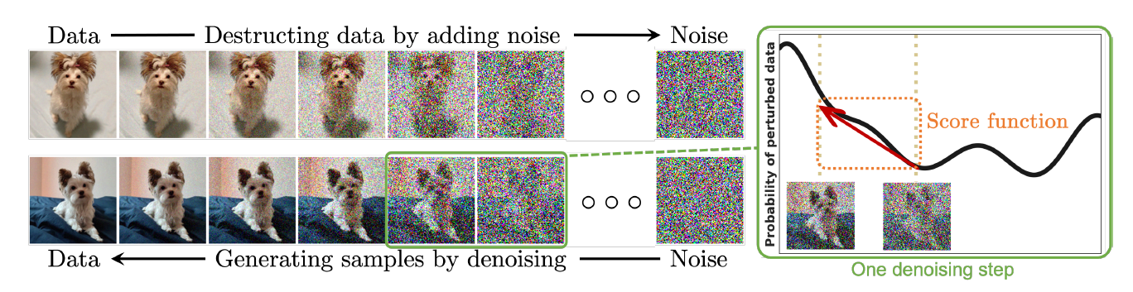
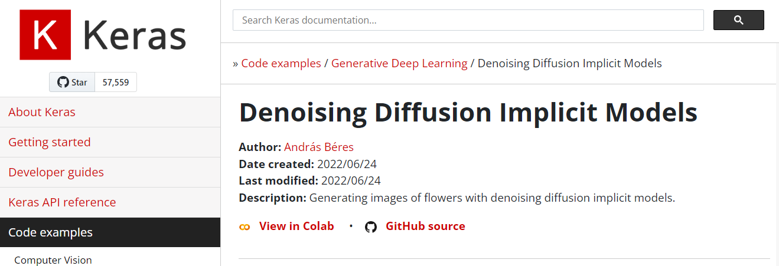
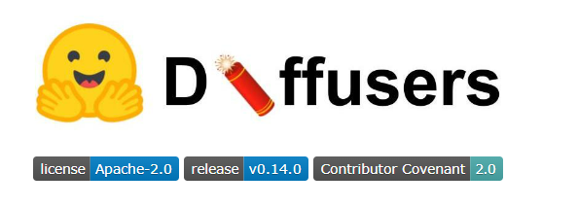
2) Diffusion Probabilistic Models smoothly perturb data by adding noise, then reverse this process to generate new data from noise.
Yang et al. (2022)

Slide 13
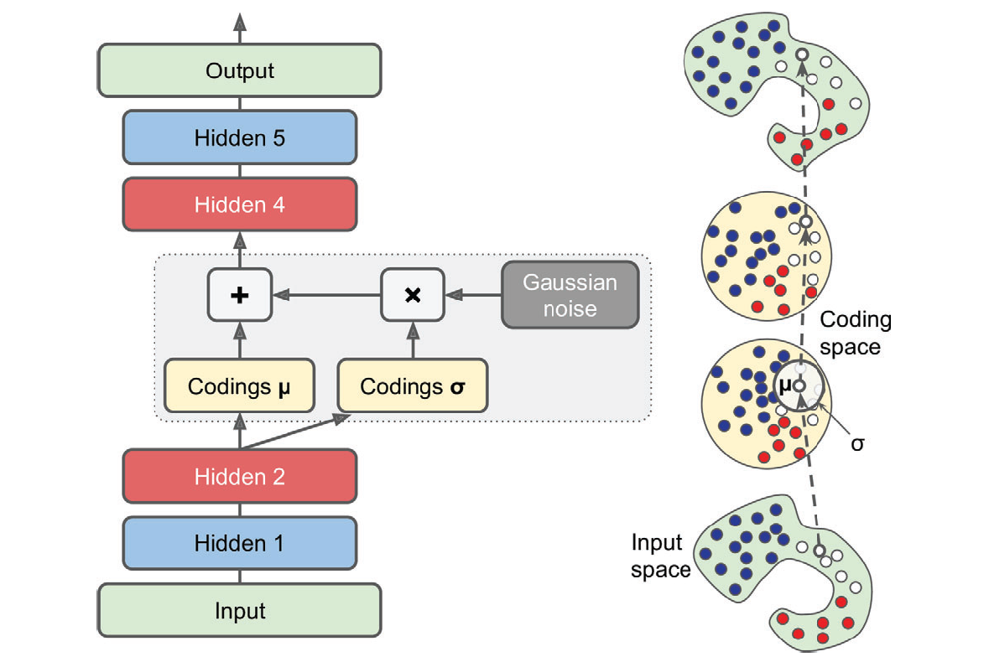
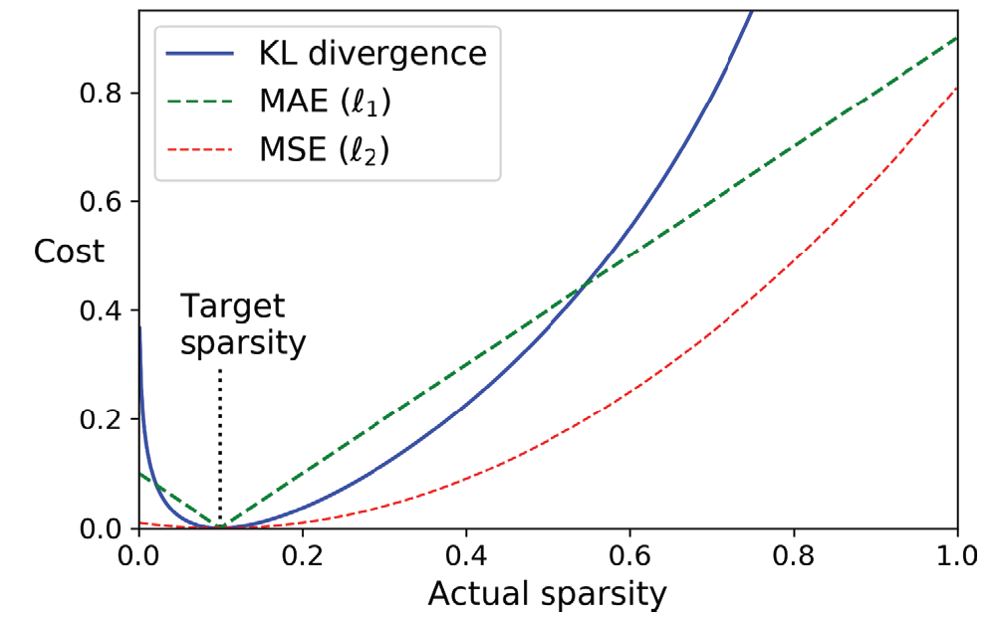
3) Variational Autoencoders probabilistically encode/decode data from latent representations

Slide 14
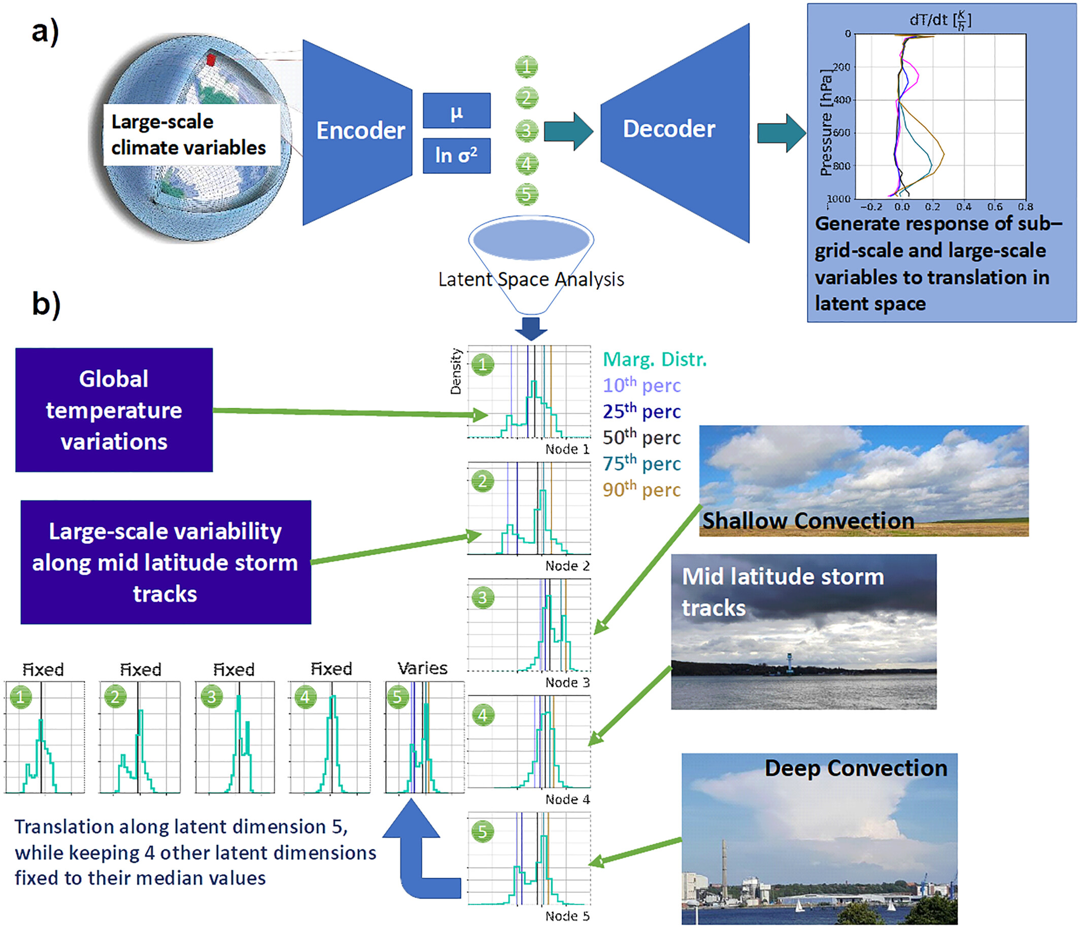
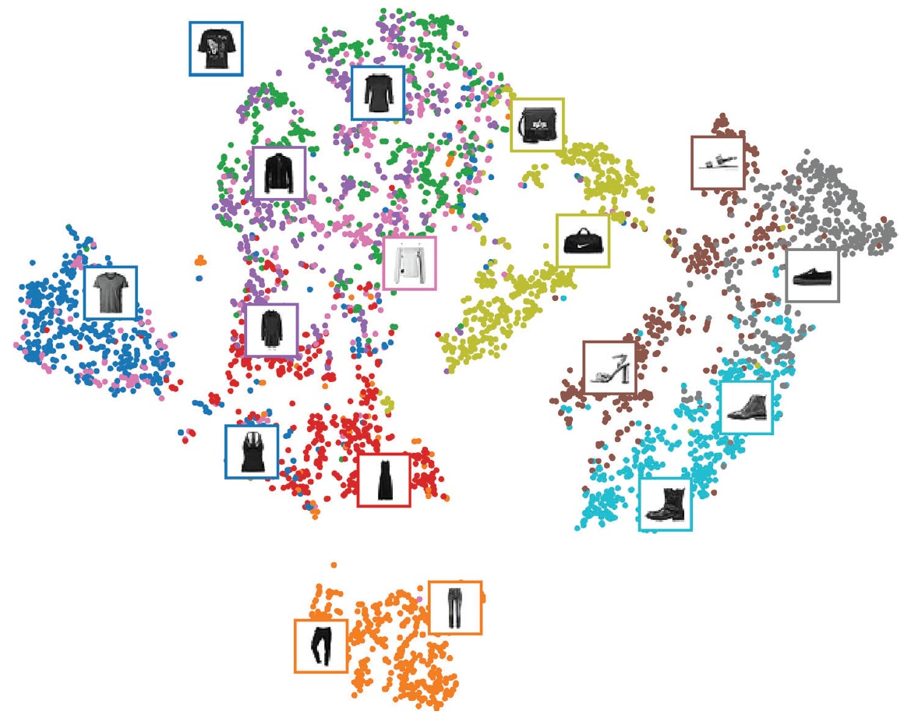
Latent manifold or “Latent space”
Géron textbook, Behrens et al. (2022)

Slide 15
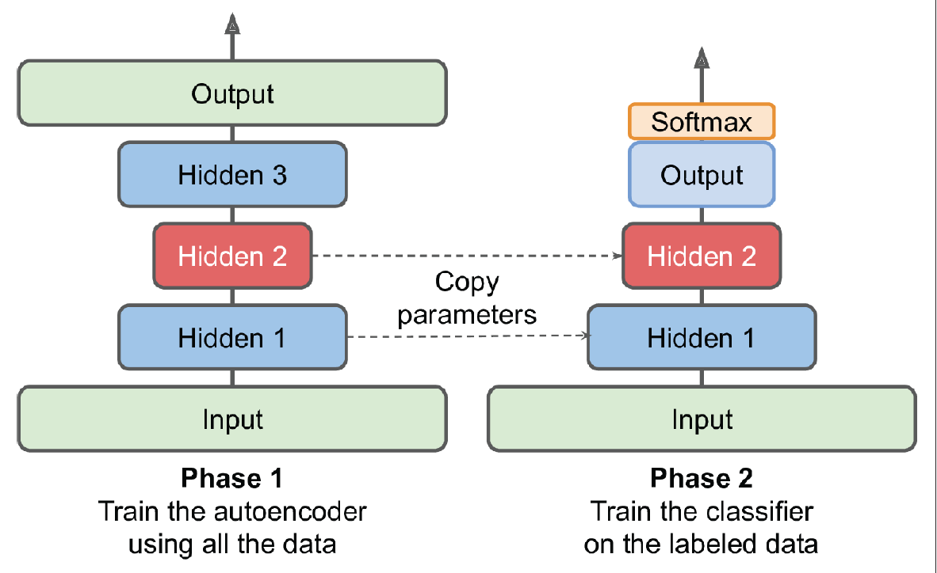
Latent manifolds can be used for e.g., scientific analysis and semi-supervised learning

